Slide 1


Corona Virus Analysis
Presented by
Ashwini Rathod MIP-DA-03

Slide 2
Introduction
The coronavirus, also known as COVID-19, is a highly contagious virus that has had a profound impact on the world. Initially identified in Wuhan, China, in late 2019, it has since become a global pandemic, affecting individuals and societies worldwide
The COVID-19 pandemic has profoundly impacted public health in several ways:
High morbidity and mortality rates worldwide.
Economic disruptions, job losses, and business closures.
Increased mental health challenges due to social isolation.
Disruption of routine healthcare services.
Strain on healthcare workers and resources.
Challenges in vaccine distribution and hesitancy.
Long-term health effects and post-viral complications.
Exacerbation of global health inequities.

Slide 3
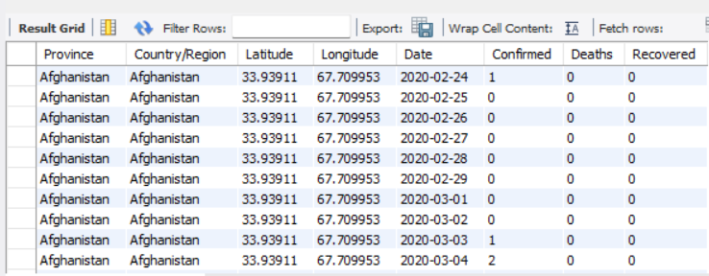

Dataset-Intro
The COVID-19 pandemic has caused a worldwide health crisis, making it essential to carefully analyze data for valuable insights to respond and manage the situation effectively. As the world faces unique challenges from the virus, it's crucial to understand how it spreads and its impact. Our analysis of the data aims to provide important information to help address and manage this significant global health crisis.
SELECT * FROM db.` coronavirus dataset (1)`;

Slide 4
Dataset Overview
01
02
03
Province
Country/Region
Latitude & Longitude
04
05
Date
Confirmed, Deaths, Recovered
Geographic subdivision
Geographic entity
Geographic coordinates
Recorded date of data
Diagnosed cases, Virus-related deaths, Recovered cases

Slide 5
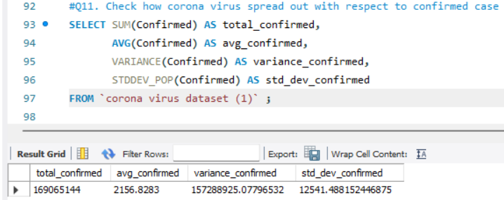

Geographic Analysis
In our dataset, the 'Confirmed' column represents the cumulative number of confirmed COVID-19 cases recorded within a specific geographic area and timeframe. This data enables us to track the progression of the pandemic and assess the effectiveness of containment measures implemented to mitigate its spread.
Query
Result

Slide 6
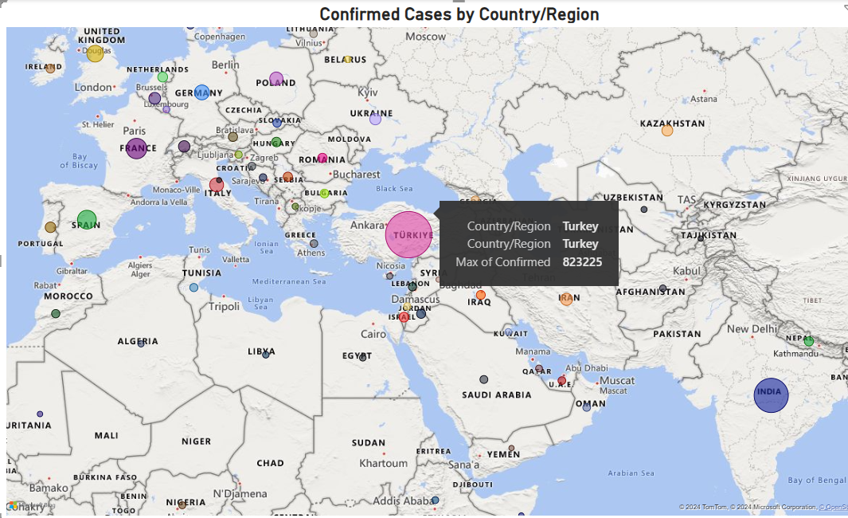
Geographic Analysis
These statistical measures provide valuable insights into the extent and variability of COVID-19 spread across different regions or periods, aiding in understanding the pandemic's dynamics and informing public health interventions.
Turkey's confirmed COVID-19 cases stand at 8,232,225, visually represented on the map, reflecting the widespread impact of the virus across the nation.

Slide 7
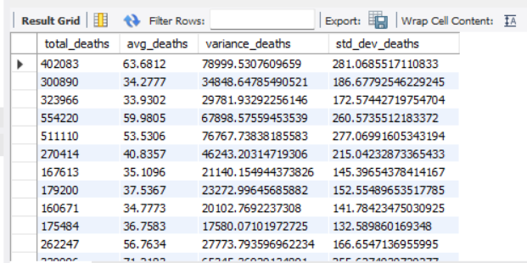
Fatalities Analysis
This query provides comprehensive statistical insights into death cases per month. By summing up the total number of deaths and calculating the average, variance, and standard deviation, it offers a holistic view of mortality trends over time. These measures help identify patterns, fluctuations, and the overall volatility of death rates throughout the pandemic.
SELECT SUM(Deaths) AS total_deaths, AVG(Deaths) AS avg_deaths, VARIANCE(Deaths) AS variance_deaths, STDDEV_POP(Deaths) AS std_dev_deaths FROM `coronavirus dataset (1)` GROUP BY MONTH(Date);

Slide 8
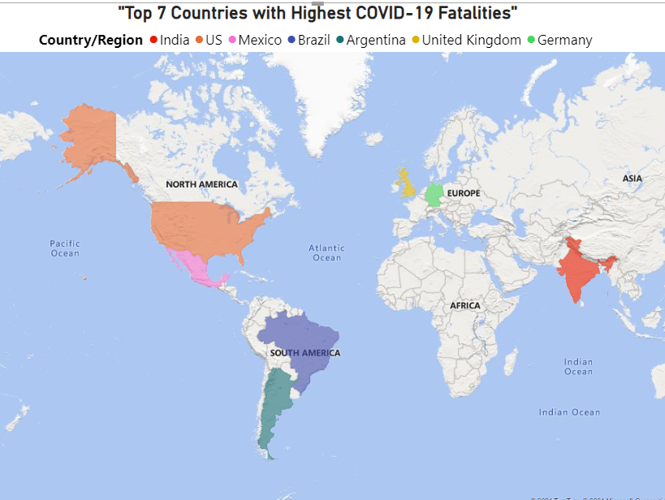
Fatalities Analysis
The analysis of death cases reveals disparities in COVID-19 impact among countries. Afghanistan has relatively fewer deaths, while India faces challenges with higher mortality rates. Understanding these variations helps in targeted interventions and resource allocation to combat the spread effectively.

Slide 9
Recovery Analysis
Recovery analysis and the query provided are vital for evaluating the global COVID-19 response, assessing healthcare system effectiveness, and guiding decisions to promote patient recovery and mitigate virus impact.
Country/Region | Total_recovered
India | 28089649
Brazil | 15400169
US | 6303715
Turkey | 5202251
Russia | 4745756
SELECT `Country/Region`, sum(Recovered) AS total_recovered FROM `coronavirus dataset (1)` GROUP BY `Country/Region` ORDER BY total_recovered DESCLIMIT 5;
The query identifies the top 5 countries with the highest number of recovered cases, providing insights into regions where recovery efforts have been most successful.

Slide 10
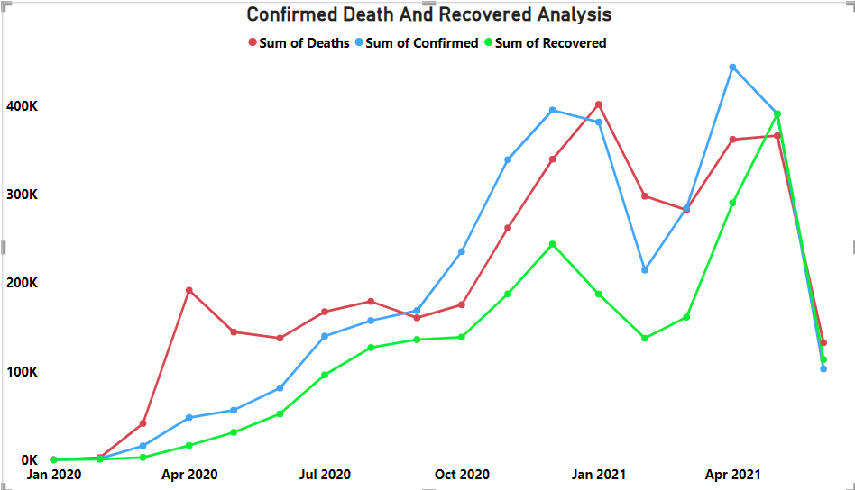
Temporal Analysis
Line chart depicting trends in confirmed, death, and recovered cases over time
The "Sum of Confirmed" and "Sum of Recovered" lines cross several times, indicating points where the number of recovered cases equaled the number of confirmed cases. The chart shows some volatility, with the number of confirmed and recovered cases peaking around the same times and then falling sharply by April 2021.

Slide 11

Conclusion
In conclusion, our COVID-19 dataset analysis highlights varying case counts and fatalities worldwide. Turkey exhibited the highest confirmed cases, while Afghanistan reported the fewest. India faced a significant number of deaths, contrasting with Afghanistan's relatively lower fatality rate. These findings underscore the importance of targeted interventions and global cooperation in addressing the pandemic's challenges, emphasizing the crucial role of data-driven decision-making in guiding effective responses and mitigating its impact.

Slide 12
Future Directions
In tackling COVID-19, we need improved surveillance, strong healthcare systems, global cooperation, rapid vaccine development, ongoing research, public education, and resilience building. These efforts will help monitor, respond, distribute resources, achieve immunity, inform prevention, raise awareness, and adapt for the future

Slide 13

A PICTURE IS WORTH A THOUSAND WORDS
Thank you

